Slide 1


Why data science? Why Python? Why now?

Slide 2
Clarification on terms: Data scientist vs Data analyst
Data Scientist
Building ML models
Data Analyst
Programming
Data transformation
Data visualization
Statistics

Slide 3

Why data science? (summary)
Data skills in high demand:
Businesses, govts, research orgs need data analysts for decision-making
Accessible job market:
Build and use your data skills from anywhere
Data skills valuable outside “data analyst/scientist” roles

Slide 4
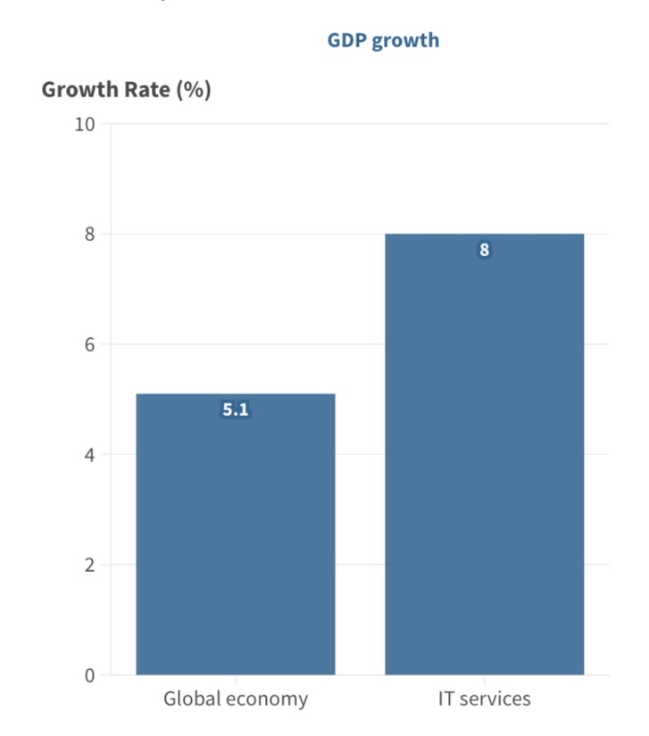
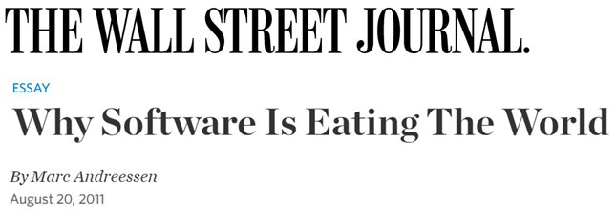
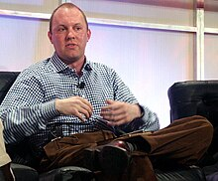
Software is eating the world
“Six decades into the computer revolution…and two decades into the rise of the modern Internet, all of the technology required to transform industries through software finally works and can be widely delivered at global scale.”
Image source https://www.flickr.com/photos/psd/49012211131
Figure source: https://openknowledge.worldbank.org/entities/publication/7617f89d-2276-413d-b0a7-e31e7527d6af?cid=pub_tt_wbpublications_en_ext

Slide 5
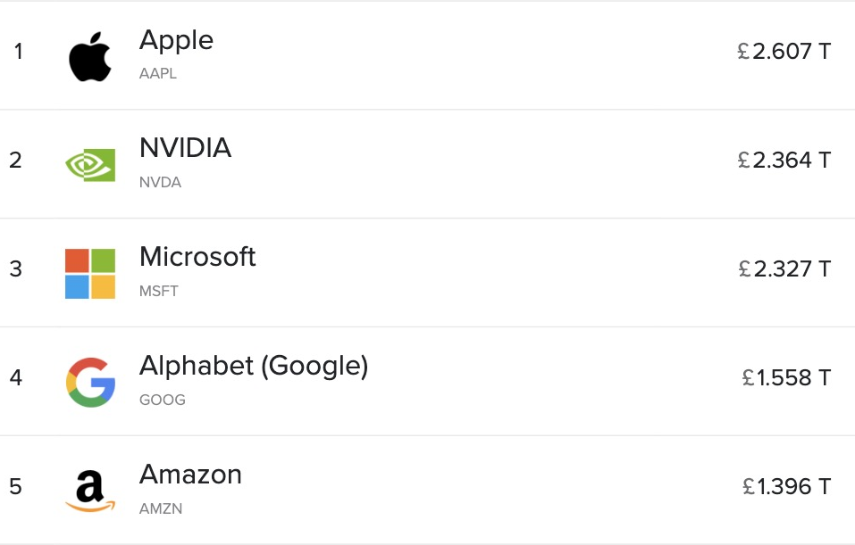
The largest companies
Figure source: https://commons.wikimedia.org/wiki/File:10_Largest_Corporations_by_Market_Capitalization.png

Slide 6
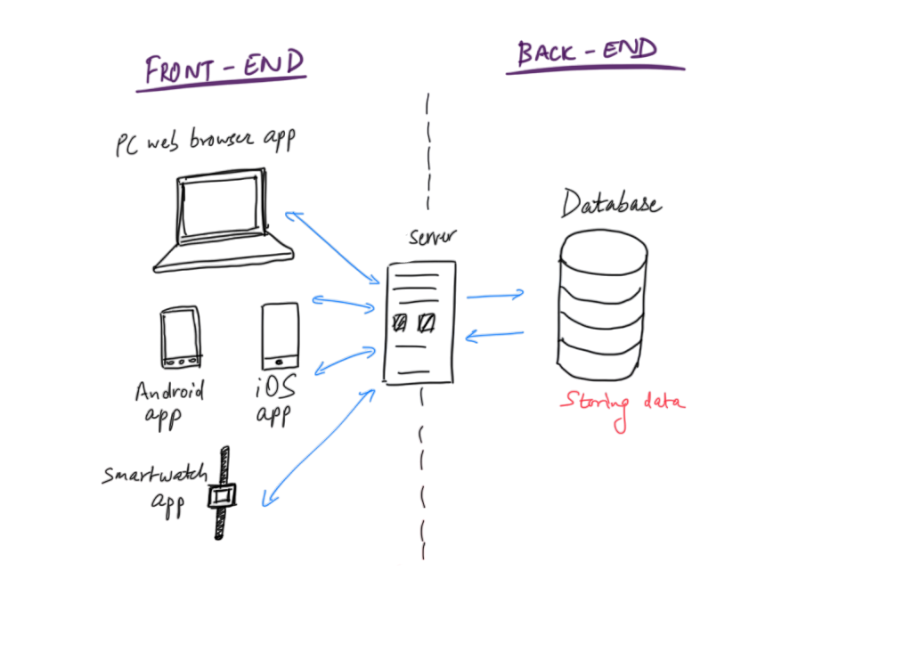
Software relies on databases
Figure source: Aman Y. Agarwal https://aman-agarwal.com/2022/11/02/databases-explained/

Slide 7
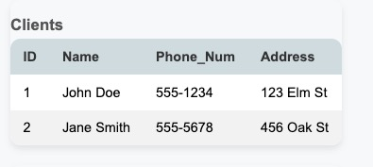
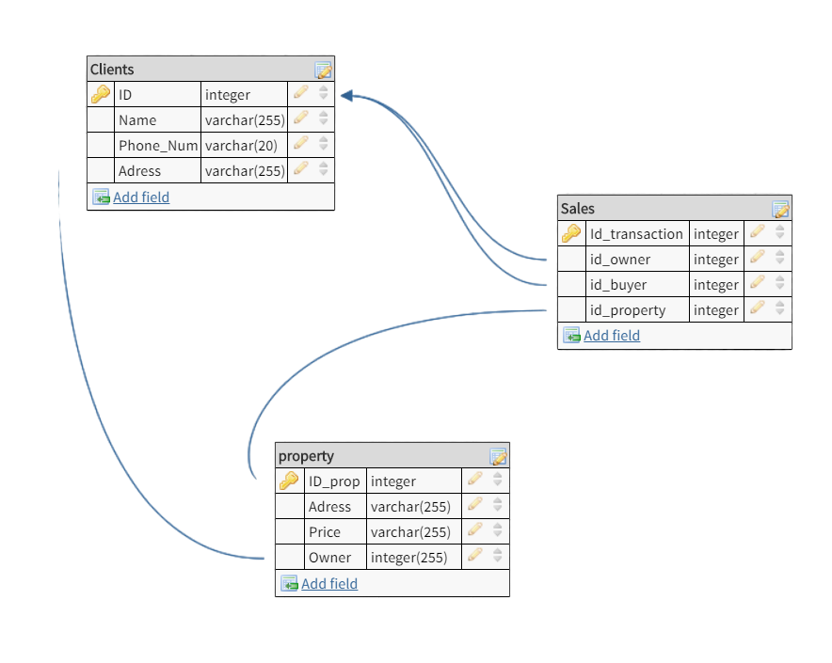
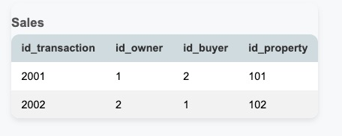
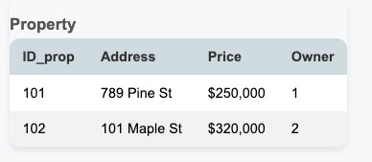
Which are collections of data tables
Figure source: https://stackoverflow.com/questions/62743441/sql-data-model-for-selling-houses

Slide 8
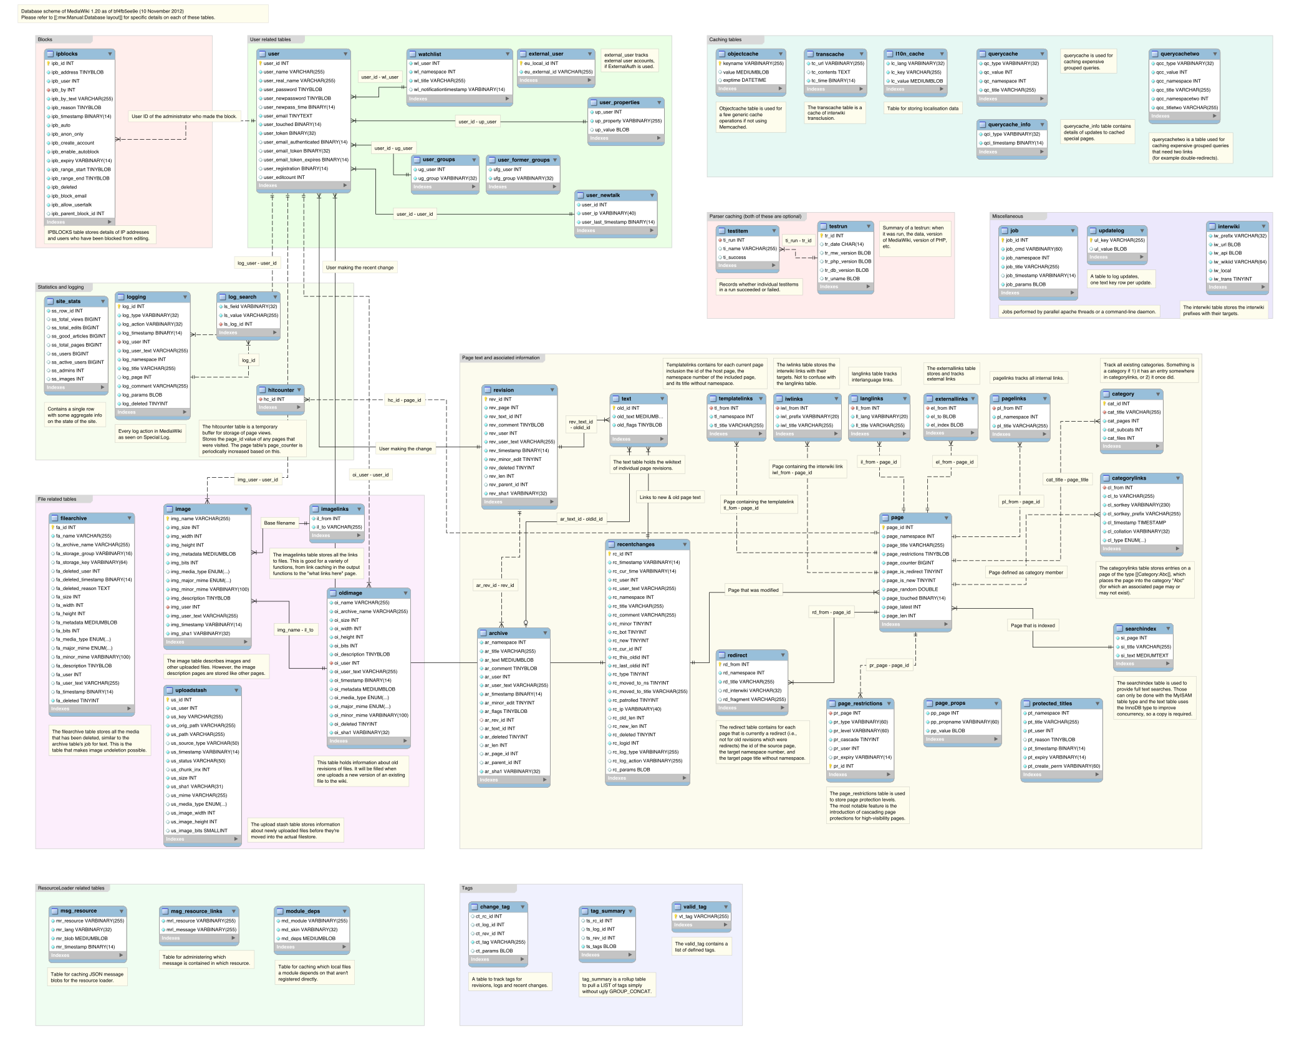
Very large collections of data tables
Figure source: https://upload.wikimedia.org/wikipedia/commons/4/42/MediaWiki_1.20_%2844edaa2%29_database_schema.svg

Slide 9



Organizations need people to help make sense of these data
Data-driven questions:
What's the optimal stock level for each product?
How do seasonal trends affect our sales?
What factors indicate a high-risk loan?
How can we identify suspicious transactions in real-time?
Which treatment protocols yield the best outcomes for THIS patient?
How can we predict and prevent hospital readmissions?
• Retail:
• Finance:
• Healthcare:

Slide 10
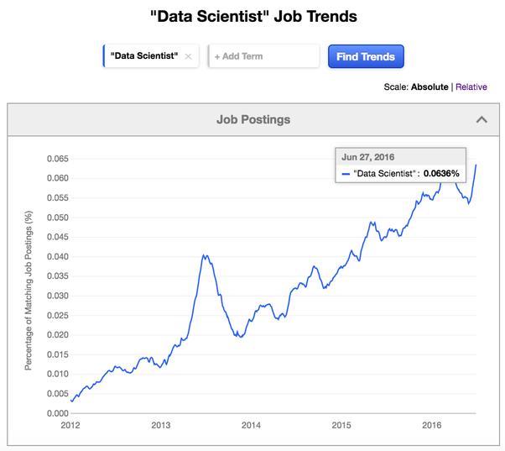
The demand for data skills has been growing
https://medium.com/@dimitrilinde/scraping-and-classifying-indeed-job-postings-for-data-occupations-part-1-22c948860e61

Slide 11
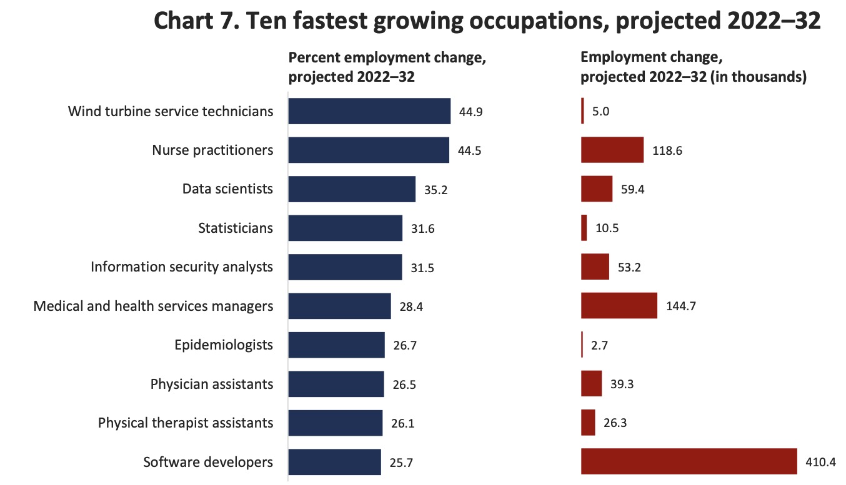
And will continue to grow
https://www.bls.gov/news.release/pdf/ecopro.pdf

Slide 12
And will continue to grow
https://www.bls.gov/news.release/pdf/ecopro.pdf

Slide 13



The data science field is uniquely attractive
- Does not need formal degree. Project is proof
- Can be learned online, from home
- Remote work friendly: globally accessible jobs
https://www.bls.gov/news.release/pdf/ecopro.pdf

Slide 14

“Data scientist/analyst” roles underestimate demand for data skills
Any decision-maker/office-worker can benefit from
Data literacy to understand metrics
Data skills to pull your own reports
Programming skills to automate repetitive tasks (especially with LLMs like ChatGPT)

Slide 15
Why data science? (summary)
DATA
Data skills in high demand:
Businesses, govts, research orgs need data analysts for decision-making
Accessible job market:
Build and use your data skills from anywhere
Data skills valuable outside “data analyst/scientist” roles

Slide 16

Why Python?
Most in-demand skill for data science
Versatile, used across industries

Slide 17
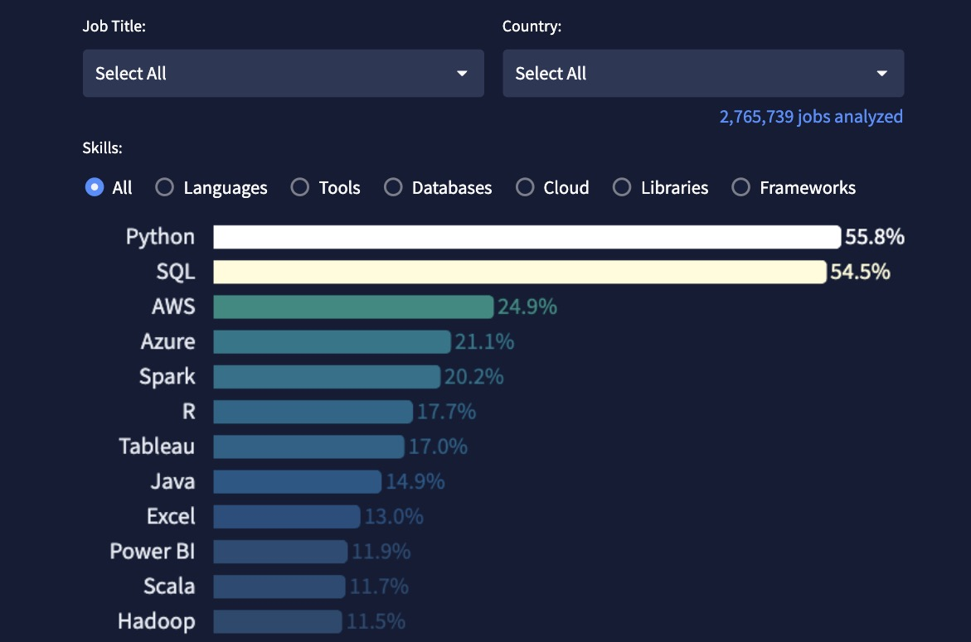
Most in-demand skill for data analysts and data scientists
https://datanerd.tech/

Slide 18








Flexible, extensible
Fixed, GUI
Flexible
Wealth of community-built packages
Data science
Web development
Geospatial analysis
Big data handling
Used across industries
Notes:
I would go quickly through this slide

Slide 19
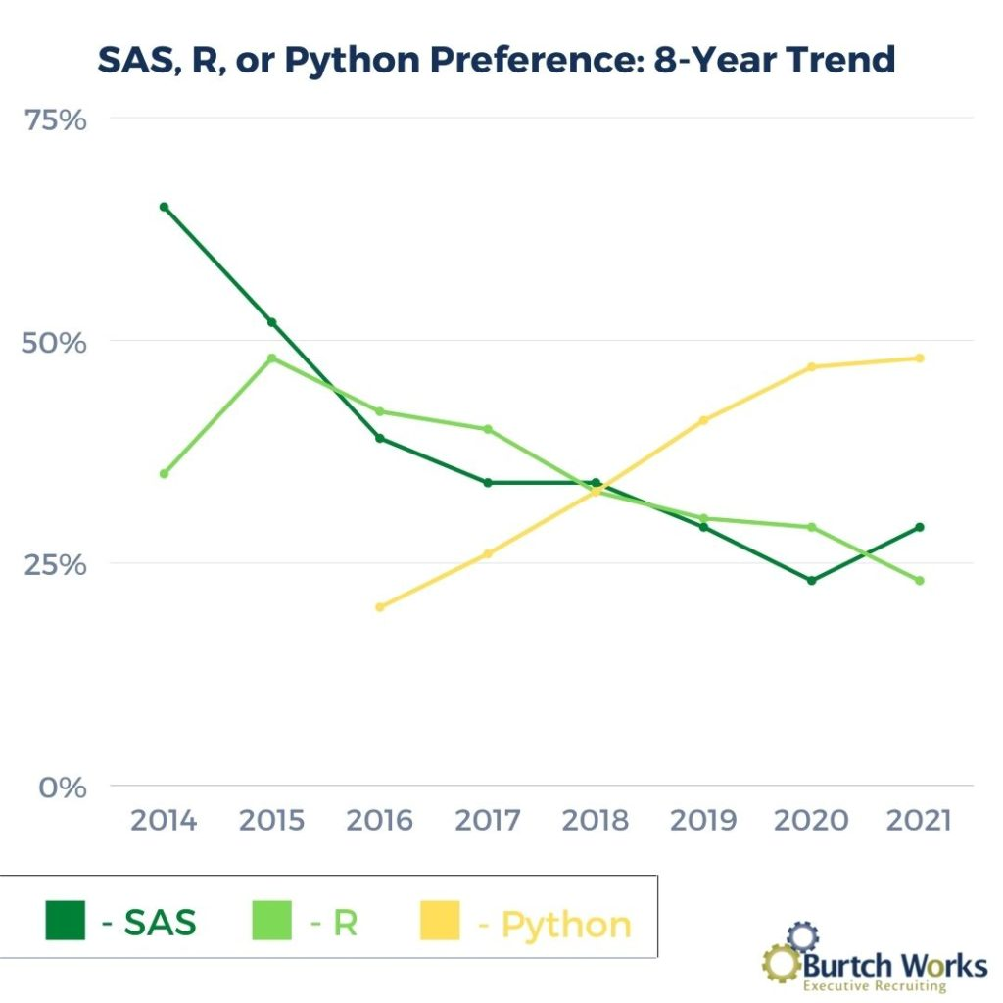
Beat R to become dominant data science language
Though R still ahead in some niche areas
Social science research
Public health research
Source: https://www.burtchworks.com/industry-insights/2021-survey-python-the-tool-of-choice-for-data-scientists-analytics-pros

Slide 20
Why Python?
Most in-demand skill for data science
Versatile, used across industries

Slide 21

Why now?

Slide 22


Is now the right time? Key trends:
High demand for data skills
Oversupply of data analysts/scientists?
AI making programming obsolete?
Low barrier to entry = many new entrants

Slide 23




Oversupply of data scientists?
Time & practice
Rich portfolio
Specialized knowledge
Wide network
Crowded pool with shallow skills
Sparse talent pool at the deep end

Slide 24
How GRAPH Courses can get you to the deep end
Time & practice
Rich portfolio
Specialized knowledge
Wide network
Crowded pool with shallow skills
Sparse talent pool at the deep end

Slide 25
How GRAPH Courses can get you to the deep end
Time & practice
Rich portfolio
Specialized knowledge
Wide network
• 9-12 month structured learning path
• Part-time and affordable: don’t quit your job or take a big loan
• Course capstone projects
• Skills for sharing work on the web
• Case studies across sectors
• Help finding datasets
• Cohort community
• 300+ cohort alumni
• Industry connections

Slide 26
Is now the right time? Key trends:
High demand for data skills
Oversupply of data analysts/scientists?
AI making programming obsolete?

Slide 27
Is now the right time? Key trends:
High demand for data skills
Undersupply of data analysts/scientists with deep expertise
AI making programming obsolete?

Slide 28



AI making programming obsolete?
LLM tools offer huge benefits. We’ll teach you to use them
Autocomplete
Chat
Pair programmer
But need significant oversight

Slide 29


AI making programming obsolete?
AI can bring you to baseline quickly.
No more getting stuck for 5 hours on easy bugs!
Once you are proficient, AI is still helpful sidekick/eager intern.
But you need expertise to direct, lead supervise!

Slide 30
Is now the right time? Key trends:
High demand for data skills
Undersupply of data analysts/scientists with deep expertise
AI making programming obsolete?

Slide 31
Is now the right time? Key trends:
High demand for data skills
Undersupply of data analysts/scientists with deep expertise
AI making programmers much more productive

Slide 32
Why data science? Why Python?
Why now?
Data skills are essential across industries
Python is the most versatile and popular tool for data science
Now is the perfect time, as demand is high and AI tools can accelerate learning and productivity

Slide 33
Thank you! See you in class

Slide 34
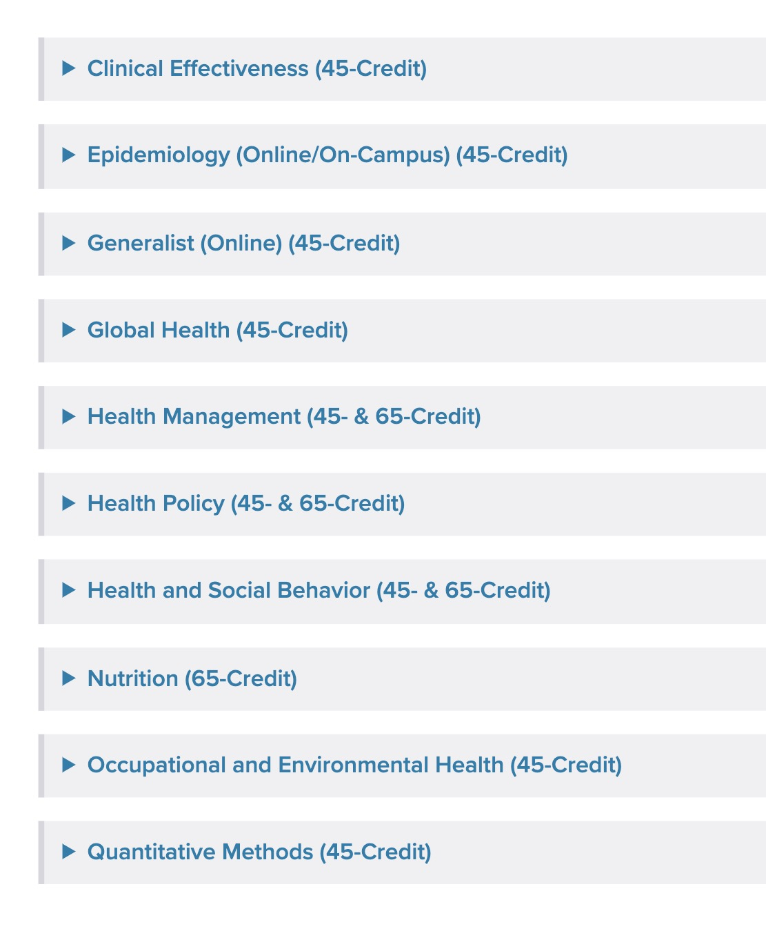
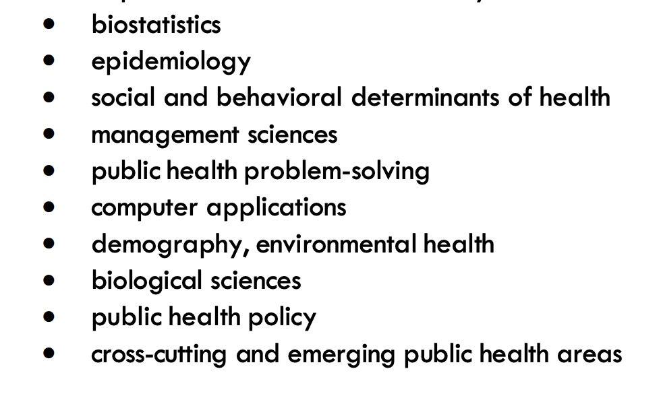
And governmental policy areas, like public health
Johns Hopkins MPH “Core Curriculum”
Harvard MPH “Study Competencies”
Johns Hopkins: https://publichealth.jhu.edu/sites/default/files/2023-10/ft-student-manual-2023-2024_0.pdf
Harvard: https://www.hsph.harvard.edu/office-of-educational-programs/master-of-public-health/mph-program-competencies/

Slide 35
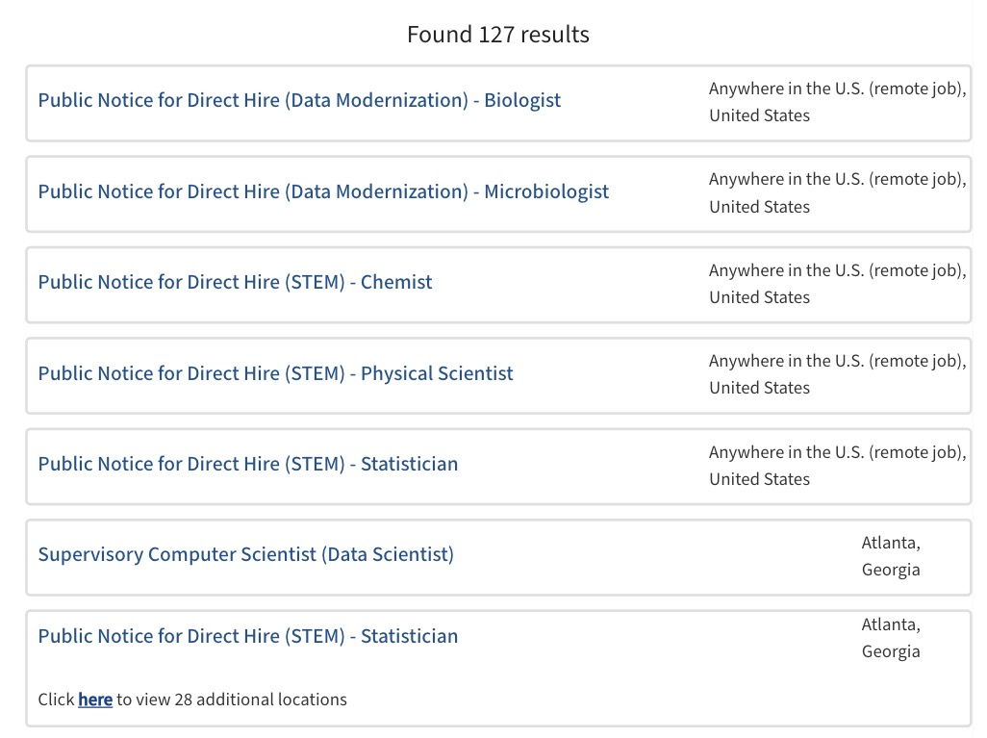
And governmental policy areas, like public health
https://jobs.cdc.gov/job-search?keywords=direct%20hire

